Slide 1
Max profit predictor - ver2
HW 9 - pD

Slide 2
Description
You can predict the stock price of MTK in the following d days.
You can make more than one transaction (buy and sell) among the following d days.
You can only hold at most 1 stock on the same day.
Calculate the maximum profit you can get.

Slide 3
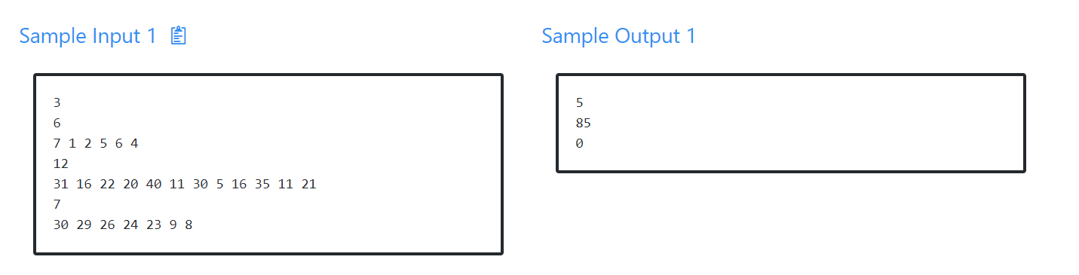
Sample Input/Output

Slide 4
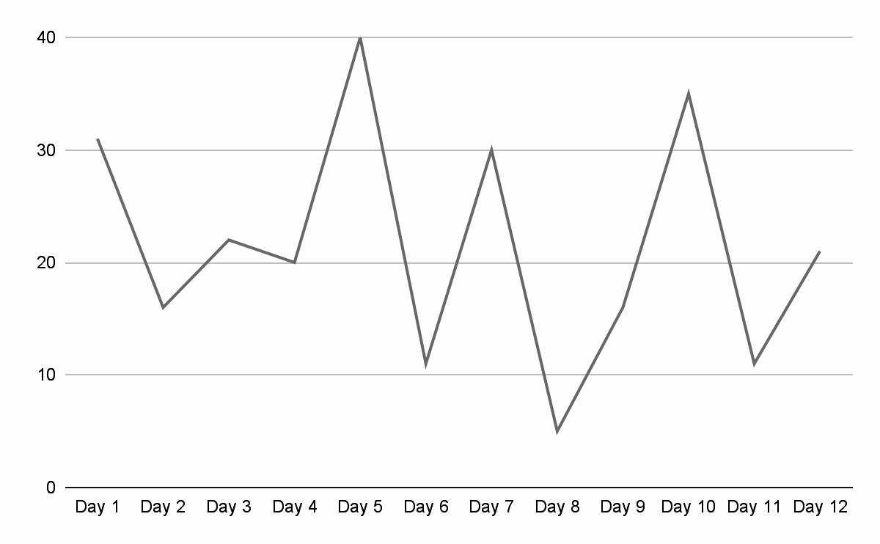
Example
D | 1 | 2 | 3 | 4 | 5 | 6 | 7 | 8 | 9 | 10 | 11 | 12
P | 31 | 16 | 22 | 20 | 40 | 11 | 30 | 5 | 16 | 35 | 11 | 21
sell
sell
For day in (2 to d)
If price[d] > price[d-1]
max_profit += price[d] - price[d-1]
sell
sell
sell
buy
buy
buy
buy
buy

